Slide 1
BOOK STORE APPLICATION
Developer : Vishal Waman
Guide : Saurabh Sir

Slide 2
INTRODUCTION
.NET TECHNOLOGY
ONLINE BOOK STORE
3. FEATURES

Slide 3
OBJECTIVES
The major objective of “Online Book Store” is to provide an essence of online book store via a simple and yet powerful medium
The project has been designed to simulate the working of an actual online book store

Slide 4
TYPE OF AUTHENTICATION
Admin Level Authentication
User Level Authentication

Slide 5
ADMIN AUTHENTICATION
Add Book
Update Book
Delete Book
Add Image
Update Image

Slide 6
USER AUTHENTICATION
Add To WishList
Add To Cart
Order Or Buy Book

Slide 7
JSON JWT TOKEN
What is JWT Token?
Claims

Slide 8
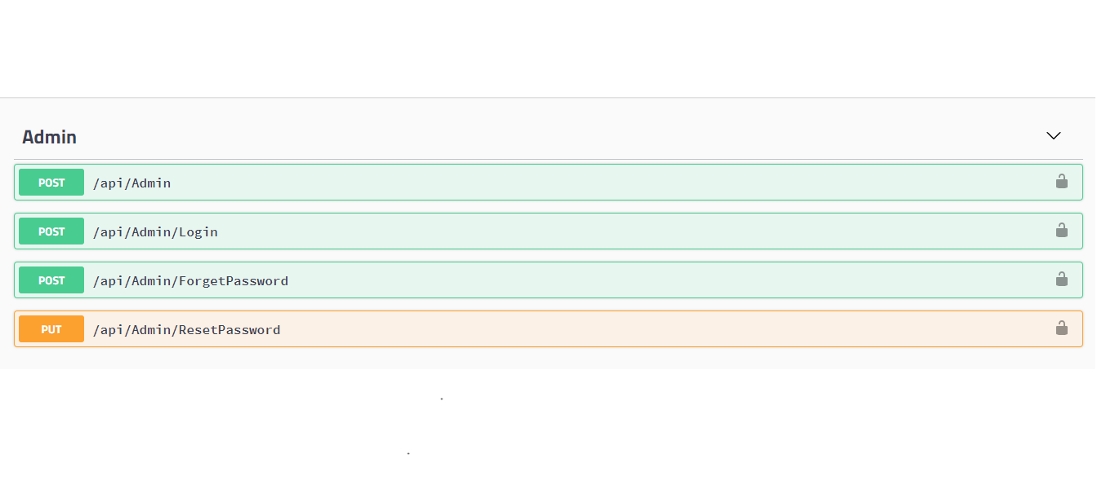
ADMIN CONTROLLER

Slide 9
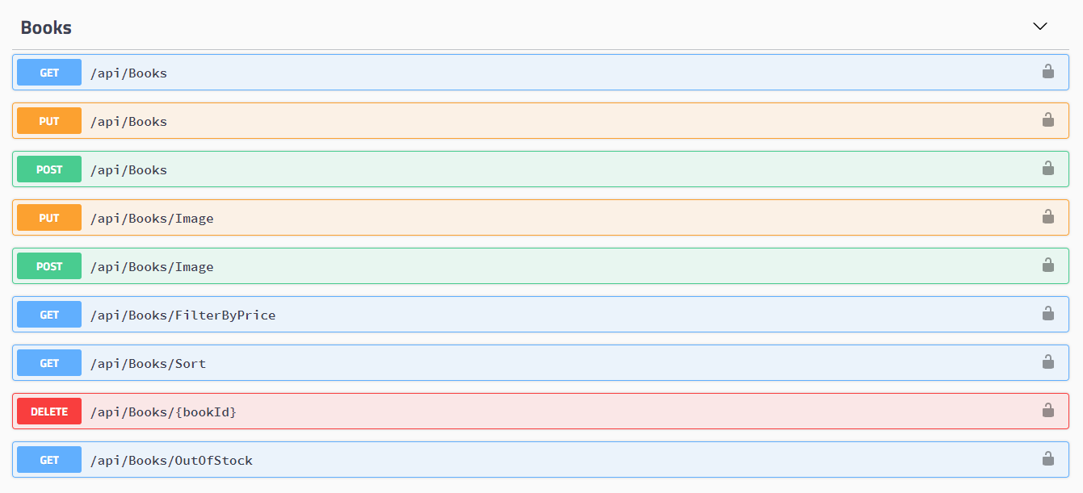
BOOKS CONTROLLER

Slide 10
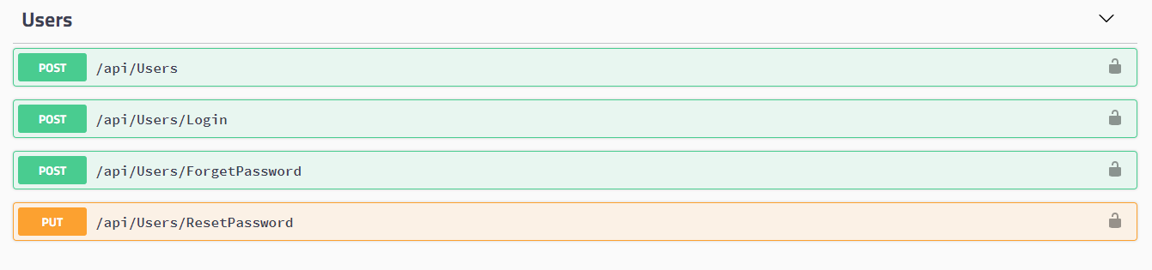
USER CONTROLLER

Slide 11
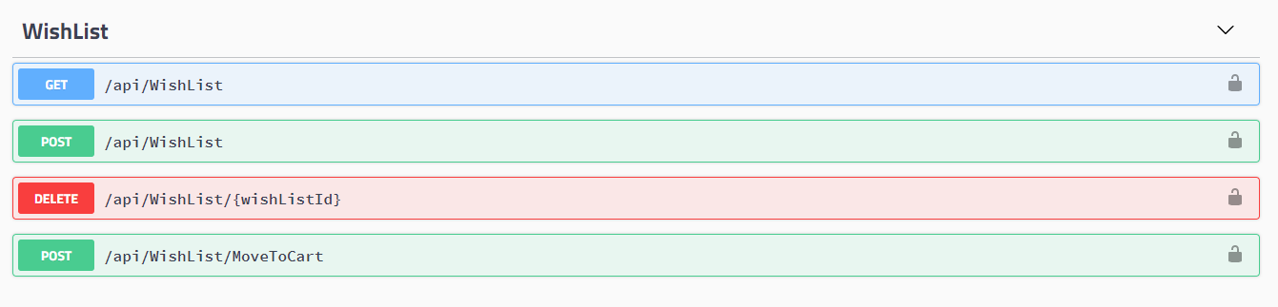
WISHLIST CONTROLLER

Slide 12
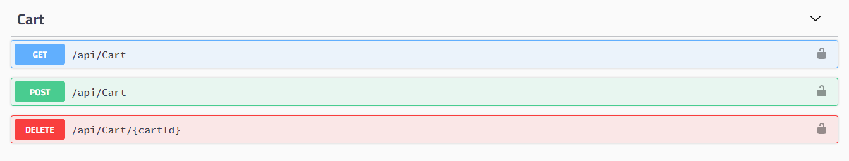
CART CONTROLLER

Slide 13
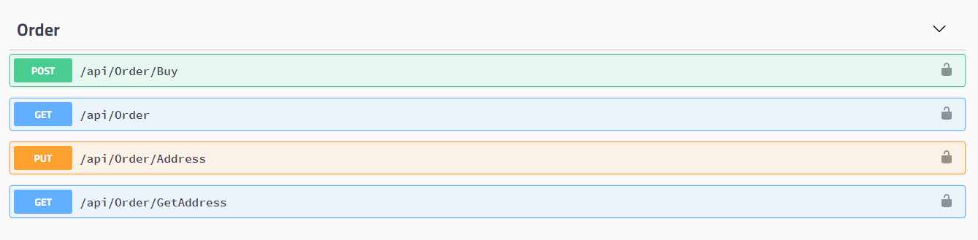
ORDER CONTROLLER

Slide 14
TECHNOLOGY
Visual Studio 2019
Microsoft SQL Server Management Studio

Slide 15
Features
MSMQ
SMTP
Unique User Authorization

Slide 16
ADVANTAGE
Time Saving
Fast Saving
View Books of all Categories

Slide 17
CONCLUSION
Book Store is an Web Application where the customer can purchase books online . Through a Web Browser the customer can search for book by title or author , later add Wish list or cart and Finally purchase the books.

